Slide 1



Natural Language Query Explorer Unlocking Insights from Data, No SQL Required
Saiprashanth Vana

Slide 2
User Inputs Natural Language Request
System Processes Input and Identifies Relevant Data
How it Works
AI Model Generates Explanation and SQL Query
BigQuery Executes SQL & Returns Results
Result Presentation

Slide 3
The Data Dictionary: Your AI's Guide to Your Data
Table Name | Column Name | Data Type | Description | Table Description | Joins_with
Plant_1_Weather_Sensor_Data: | DATE_TIME | object | Timestamp indicating the date and time of the record in Plant_1_Weather_Sensor_Data. | The table Plant_1_Weather_Sensor_Data provides data pertaining to weather sensor measurements, including temperature readings, timestamps, and related identifiers. | NULL
Plant_2_Weather_Sensor_Data: | PLANT_ID | INT64 | Identifier for the plant associated with the record in Plant_2_Weather_Sensor_Data. | The table Plant_2_Weather_Sensor_Data provides data related to weather sensor readings, focusing on environmental and operational metrics for Plant 2. | NULL
Plant_1_Generation_Data | DC_POWER | float64 | Ambient temperature recorded by sensors in Plant_2_Weather_Sensor_Data. | The table Plant_1_Generation_Data records data related to power generation metrics for Plant 1, including timestamps and generation values. | NULL
Plant_2_Generation_Data | AMBIENT_TEMPERATURE | float64 | unique identifier assigned to each invoice generated by a business. It’s used for tracking, reference, and record-keeping purposes | The table Plant_2_Generation_Data records data related to power generation metrics for Plant 1, including timestamps and generation values. | NULL

Slide 4
User Inputs a natural language query
System Processes the Query
The Text-to-SQL Pipeline
Generate Embeddings for Query & Create Contextual Prompts
Perform Semantic Search using Embeddings
AI Model gives Explanation & Generate SQL
Data Dictionary
BigQuery Executes the Query & Returns Result
Results are Presented to the User in a user-friendly format

Slide 5
Understanding Embeddings: The Key to Semantic Search
Table Description
Embeddings
The table Plant_1_Weather_Sensor_Data provides data pertaining to weather sensor measurements, including temperature readings, timestamps, and related identifiers.
0 [-0.011527352966368198, -0.03613739833235741, ...
1 [0.02232014201581478, -0.03280224651098251, -0...
2 [0.03376839682459831, -0.03873751685023308, -0...
3 [0.028388207778334618, -0.03461480513215065,

Slide 6
Crafting the Perfect Prompts: Guiding the AI
PROMPT 1
PROMPT 2
You are an AI assistant designed to identify relevant tables and columns for SQL query generation based on the provided context and data schema.
"""
Your task is to:
1. Identify all the TABLES and COLUMNS necessary to fulfill the SQL query.
2. Explain why these specific tables and columns were selected.
3. Identify and explain the joins required between tables, including the key columns used for the joins.
4. STRICTLY DO NOT GENERATE SQL QUERY.
Table Name | Column Name | Data Type | Description
Plant_1_Weather_Sensor_Data | IRRADIATION | float64 | Description for IRRADIATION in Plant_1_Weather_Sensor_Data.
Plant_2_Generation_Data | DATE_TIME | object | Timestamp indicating the date and time of the record in Plant_2_Generation_Data.....
Question: <User Query>
Output the following fields:
Tables Required
Columns Required
Joins
Explanation
"""
"""
You are an AI assistant designed to generate SQL queries for the Onelook BigQuery database.
Write a SQL Query. Use the project and dataset `prj-ot-dev-bqsandbox-000001.onelook_test` as default for all tables when writing the SQL Query. Use joins if needed.
You have access to the following tables. ONLY use these tables:
<Recommended Data Dictionary Entries from Prompt 1>
<Example 1 question/explanation/query>
<Example 2 question/explanation/query>
...
Question: <User Query>
Explanation: <Explanation from prompt 1>
SQL:
"""

Slide 7
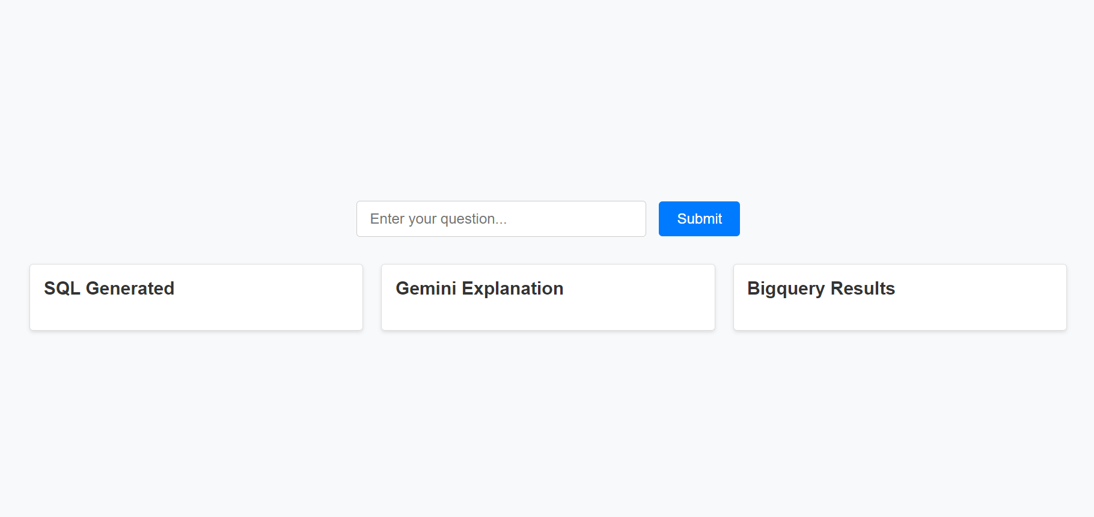

Slide 8
What is the Average ambient temperature in plant with ID as '4135001'?
Explanation Response: **Tables required:** - Plant_1_Weather_Sensor_Data - Plant_2_Weather_Sensor_Data **Columns required:** - Plant_1_Weather_Sensor_Data.AMBIENT_TEMPERATURE - Plant_2_Weather_Sensor_Data.AMBIENT_TEMPERATURE - Plant_1_Weather_Sensor_Data.PLANT_ID - Plant_2_Weather_Sensor_Data.PLANT_ID **Join:** - Plant_1_Weather_Sensor_Data.PLANT_ID = Plant_2_Weather_Sensor_Data.PLANT_ID **Explanation:** To find the average ambient temperature for a specific plant, we need to join the Plant_1_Weather_Sensor_Data and Plant_2_Weather_Sensor_Data tables on the PLANT_ID column. This will allow us to combine the temperature readings for both plants and calculate the average. **Query:** Warning: The generated SQL query uses columns not mentioned in the explanation. SQL Query: SELECT AVG(ambient_temperature) AS average_ambient_temperature FROM `impactful-water-442413-t7.nlqe.Plant_1_Weather_Sensor_Data` WHERE PLANT_ID = 4135001; average_ambient_temperature 0 25.531606
To find the average ambient temperature for a specific plant, we need to join the Plant_1_Weather_Sensor_Data and Plant_2_Weather_Sensor_Data tables on the PLANT_ID column. This will allow us to combine the temperature readings for both plants and calculate the average.
 | average_ambient_temperature
0 | 25.531606

Slide 9
Thank You!

